Slide 1

Aviation Project
- Group I

Slide 2
Table of Contents
Project Recap
Problem
Analytics Team
Insights
Summary

Slide 3
Project Recap
Aviation data analysis with given flight data was done
The insights for the given four KPI’s were analyzed.
Tools used :
Data Cleaning – Excel, Power Query
Data Analyzation – MySQL
Visualization – Power BI, Tableau

Slide 4
Problem
Weekday Vs Weekend total flights statistics
Total number of cancelled flights for JetBlue Airways on first date of every month
Week wise, State wise and City wise statistics of delay of flights with airline details
Number of airlines with No departure/arrival delay with distance covered between 2500 and 3000

Slide 5
Analytics Team
Aarthi Meena
Sai Preethi
Anjaly
Navya
Jones
Chinta Srinivas
Muhammed

Slide 6
Insights

Slide 7
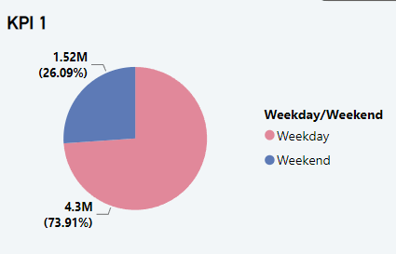
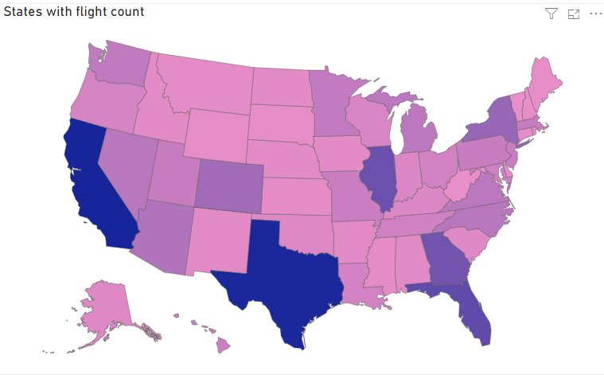
Weekday Vs Weekend total flights statistics
Number of Flights
Weekdays has more number of flights than weekends. Weekday accounted for 73.91% of flights.
﻿Southwest Airlines Co. has made up 16.11% of total number of flights and California has highest number of flights.

Slide 8
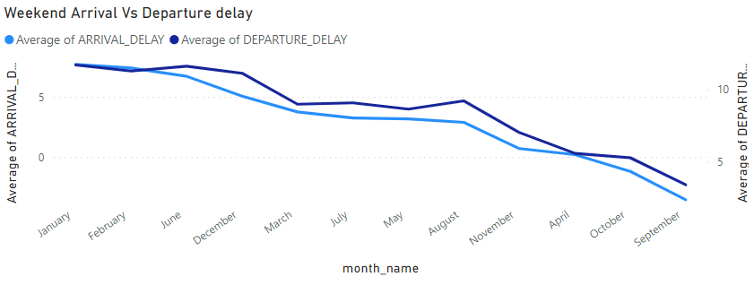
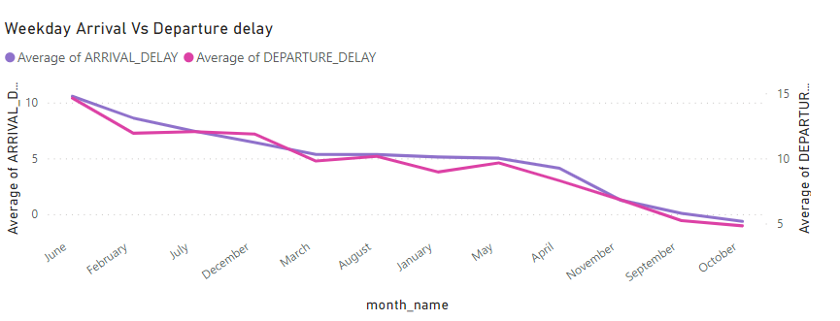
Departure and Arrival Delay
Weekend
January month has highest arrival delay (7.70) which was 317.21% more than September which has lowest arrival delay (-3.55).
Departure delay and arrival delay has diverged most in the month of September where departure delay is 6.79% higher than arrival delay.
Weekday
June month has highest arrival delay (10.57) which was more higher than October which has lowest arrival delay (-0.64).
Departure delay and arrival delay has diverged most in the month of November where departure delay is 5.57% higher than arrival delay.

Slide 9
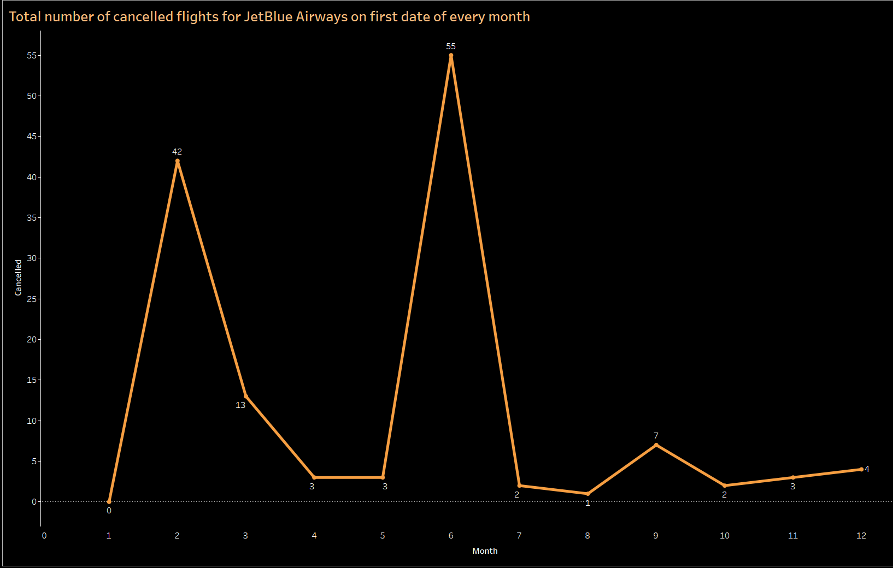
Total number of cancelled flights for JetBlue Airways on first date of every month
From this analysis we got to know that for JetBlue Airways the number of flight cancelled on first date of every month is maximum for the 6th Month.
Maximum number of flights cancelled is 55 which is in the month of June.
American Eagle is the airline which has maximum number of cancelled flights.
In the month of January there is no cancelled flights.
Cancelled flights is zero in month of January and maximum in the month of June.

Slide 10
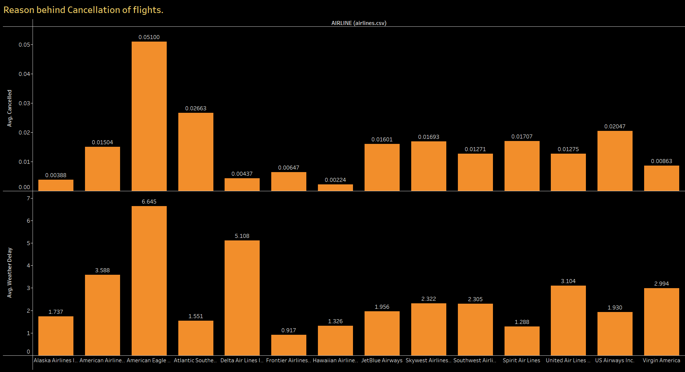
Weather delay is the main reason why the American Eagle Airlines has maximum no of cancelled flights.

Slide 11
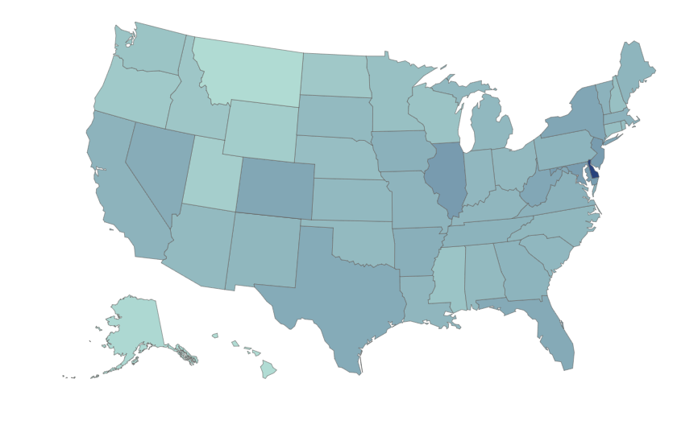
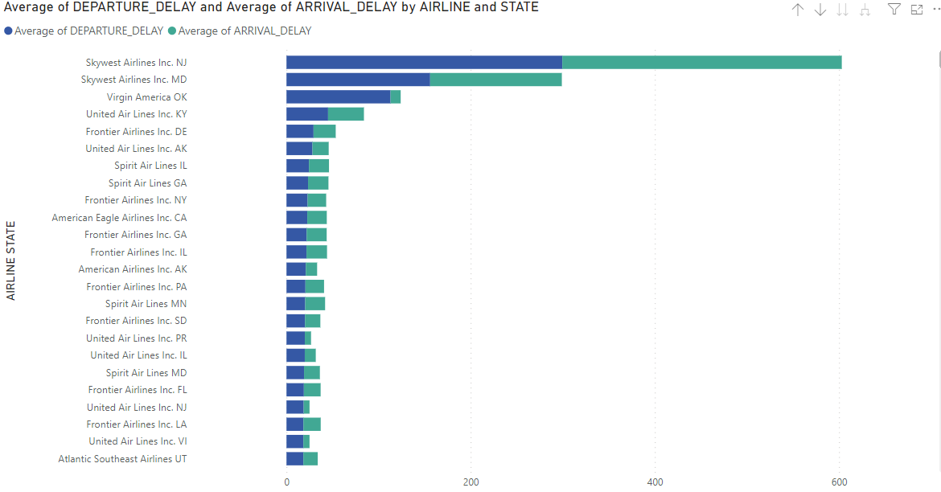
State-wise delay statistics
Texas, California and Nevada has most delays.
Late aircraft delay is major reason for delay of flights.
Sky West airline of New Jersey has contributed to most of the delays.

Slide 12
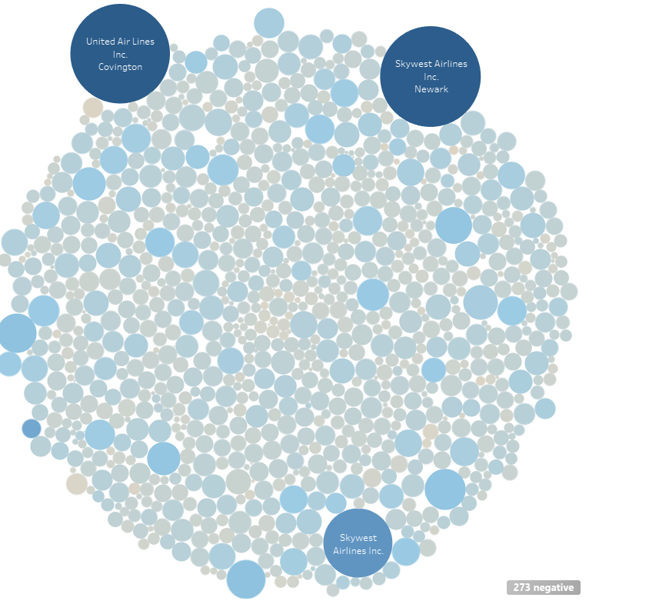
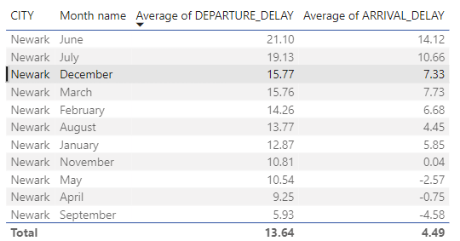
City wise delay statistics
Sky West Airlines of Newark city and United Airlines of Covington has most arrival and departure delay.
Flights of Newark city in the month June has most delay.

Slide 13
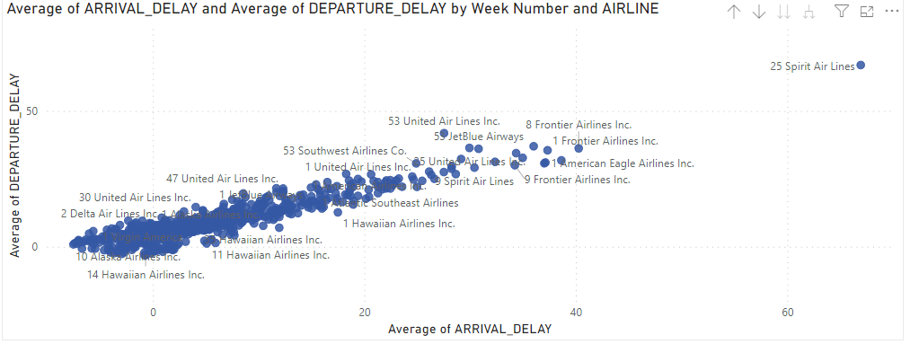
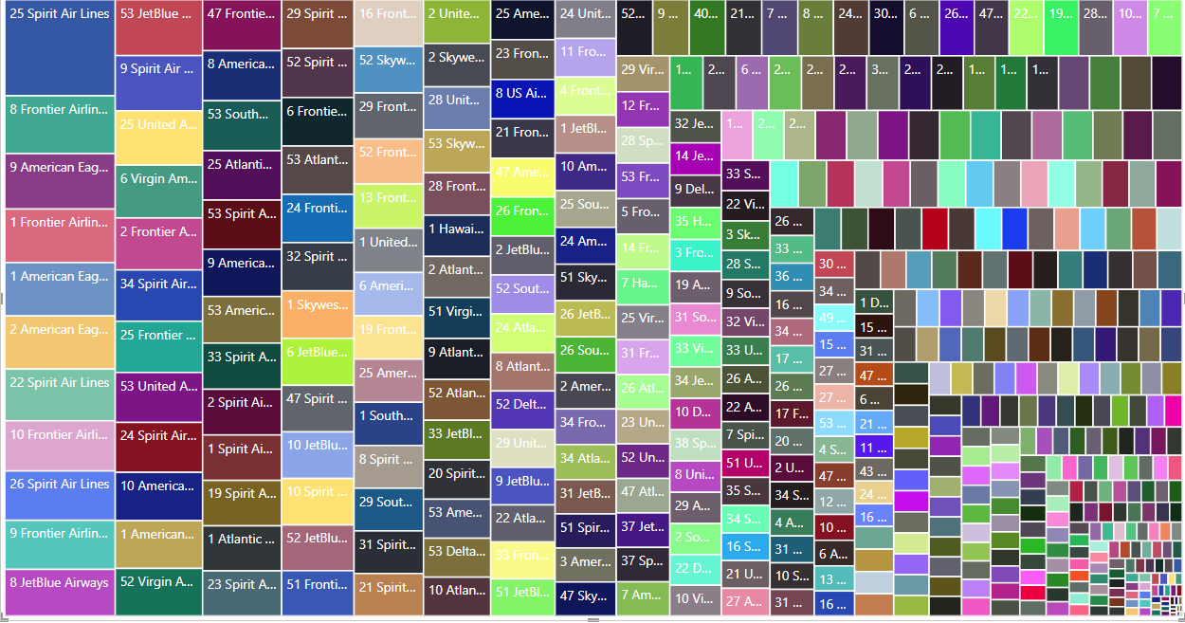
Week wise delay statistics
Spirit Airlines has the most arrival and departure delay in 25th week (June Month) of the year.
Air system delay has contributed most for the delay.
Frontier Airline has the next most delays in 8th week (February month) of the year.

Slide 14
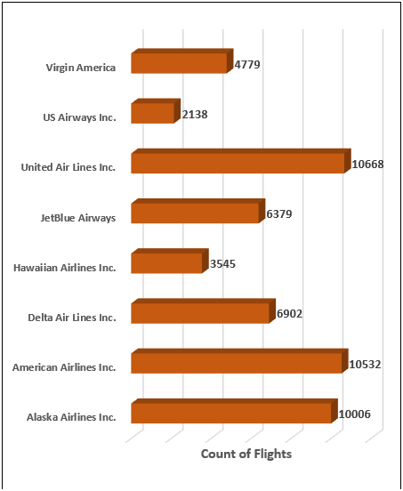
Number of airlines with No departure/arrival delay with distance covered between 2500 and 3000
The following chart is the representation of Count of flights of each airlines whose distance covered are between 2500 and 3000 without any departure or arrival delay.
Total there are 8 airlines which falls under the above mentioned category.
Total number of flights of all airlines without delay are 54949.
United airlines Inc. is having more highest flights without any delay with a count of 10668.
US airways Inc. is having least number of flights without delay with a count of 2138.
American Airlines Inc. stands second highest without any flight delays at 10532.

Slide 15
Summary
Southwest Airlines in California has highest number of flights.
American Eagle Airline has most number of cancelled flights.
Weather and aircraft issue contributed most for the cancellation and delay of flights.
Flights of United Airlines seems to more punctual without any delays.

Slide 16
THANK YOU

